Slide 1
MyCellar Application Development Project
Veronique Karwowska
Turcan Madalina

Slide 2
Project Description
MyCellar is a simplified application that tracts your wine collection as well as records your rating of the wines that you have tasted for future reference. Each product will have a short description, an image and the quantity at hand.

Slide 3
Activity Screens
01
Splash Screen
02
Login Screen and Sign Up
04
Tasted Collections Screen
04
Untasted Collection Screen
03
Home Screen
06
Product Details Screen
07
Eddit and Create Screens
07
Wine suggestions
Screen

Slide 4

SPLASH SCREEN
Screen displayed while the app is loading or opening

Slide 5
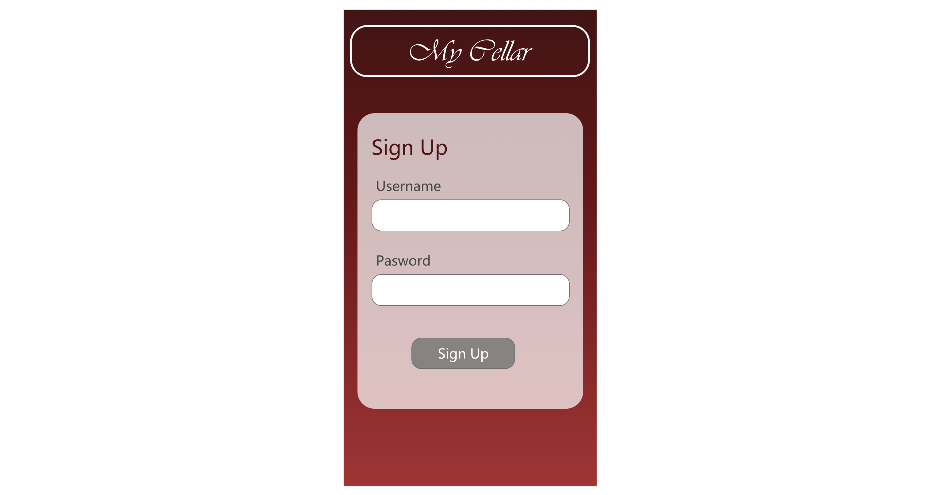
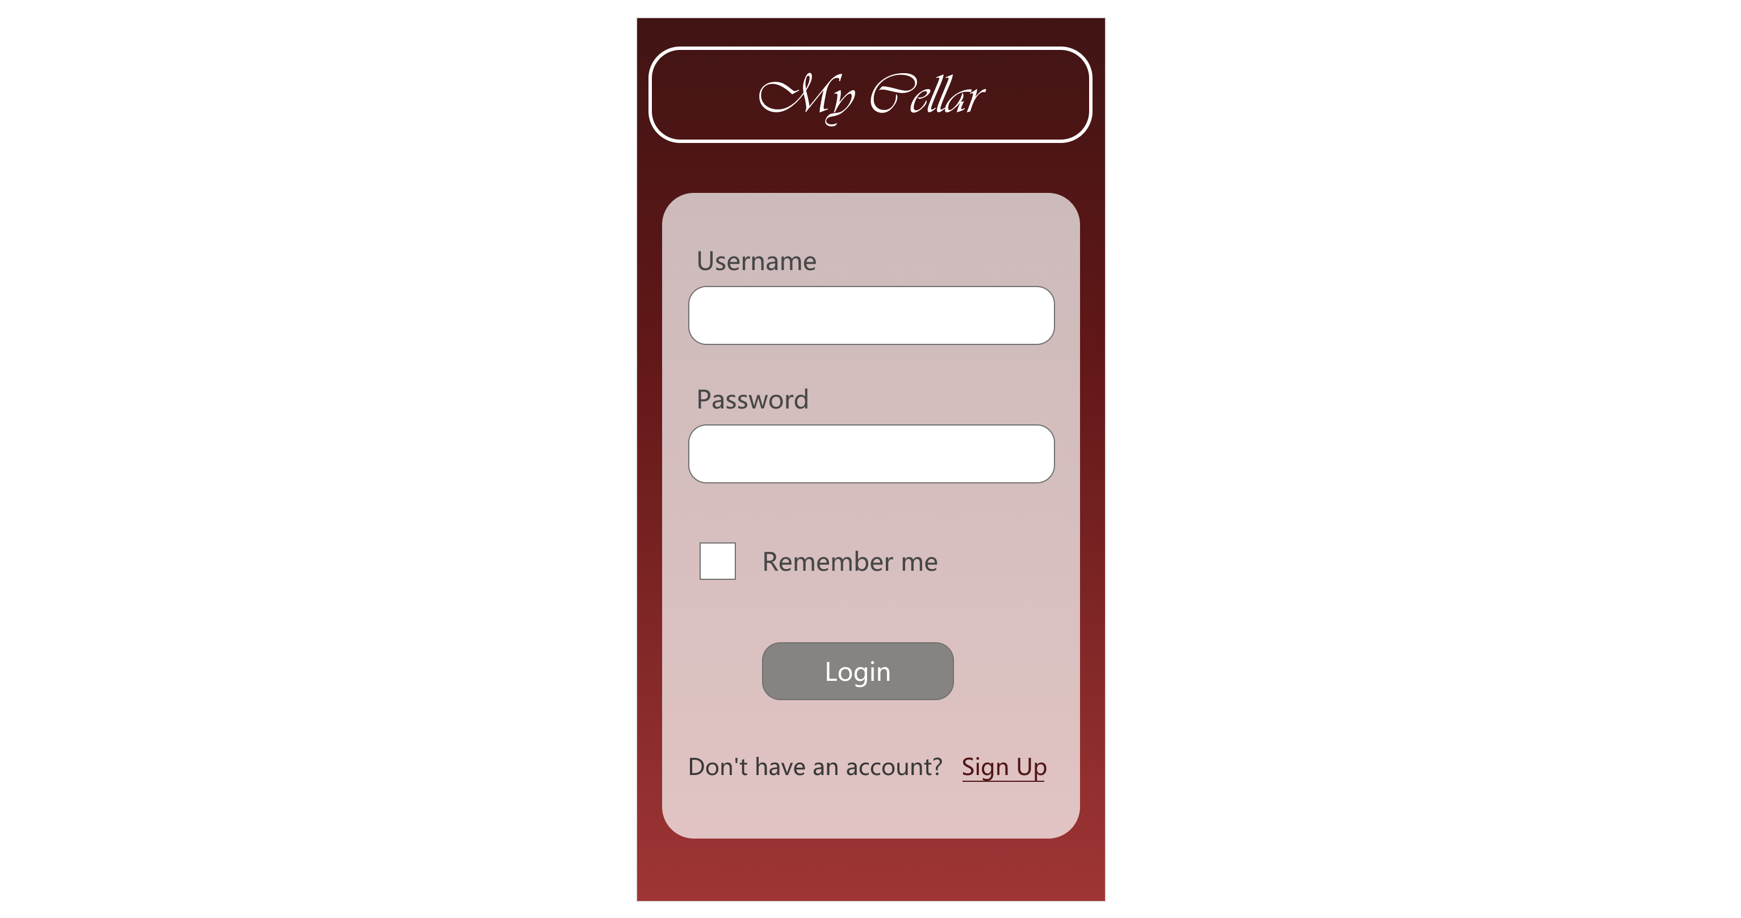
LOGIN / SIGN UP SCREEN
The Login screen of the application will have an option to remember the username, this will make the sign in process more efficient as the user will spent less time entering their credentials.
Can create an account if you don’t have one yet.

Slide 6
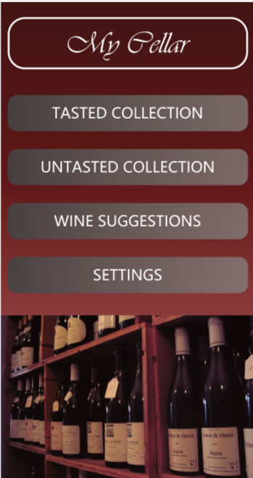
HOME SCREEN
Four buttons are featured. Clicking any of them will open the appropriate activity

Slide 7
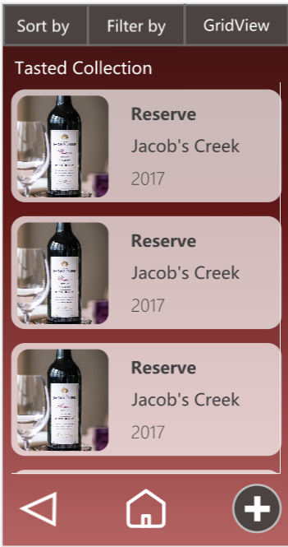
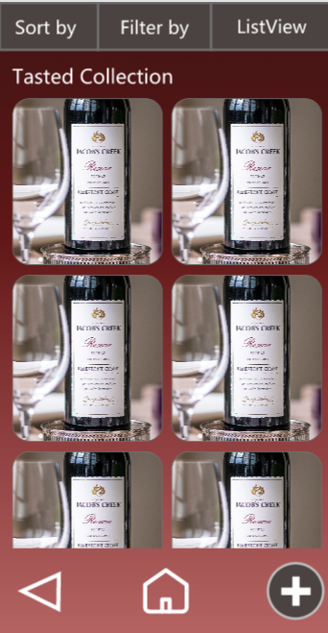
TASTED COLLECTION
Using a RecylerView to list of all products tasted before and rated
User will be able to sort by alphabetical order, price, rating, or quantity
User will be able to filter by type, or producer.
There will also be a ‘Add’ floating action button on both the Tasted Collection and Untasted Collection pages that when clicked, will open a form to add a wine to the wine list.
Clicking the wine links will open their page with the following information

Slide 8
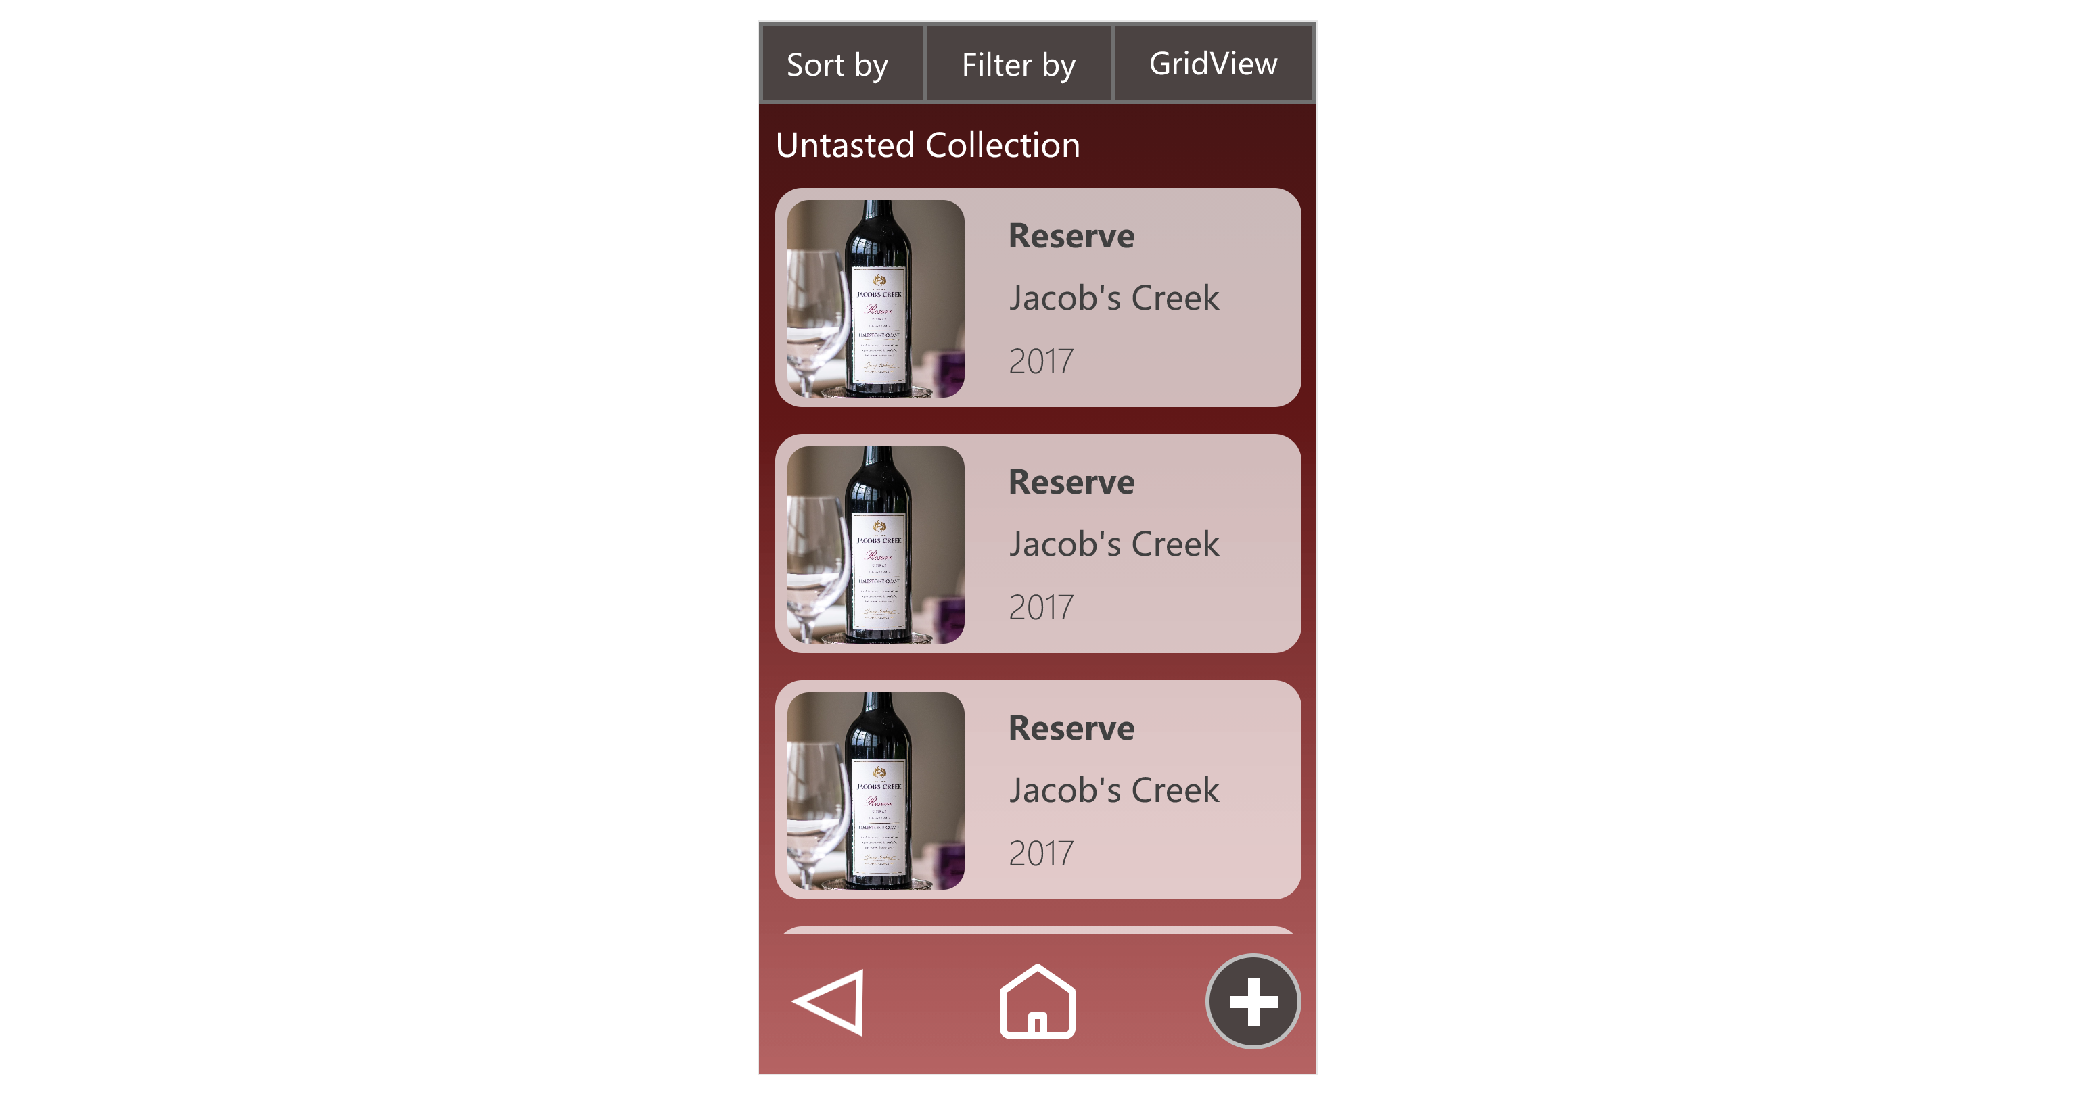
UNTASTED COLLECTION
The same layout and functionalities as for the Tasted Collection, only difference is that the details of the wine will not include the user’s rating

Slide 9
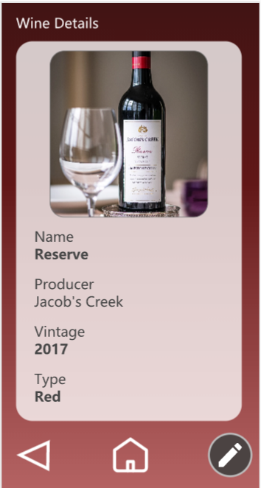
WINE DETAILS
The following information will be displayed about the wine:
-Name
-Producer
-Vintage
-Picture
-Type
-Rating*
-Quantity on hand
-Price
-Additional information
* Only for Tasted Wine Collection
The user will be able to edit the wine information by clicking the Edit floating action button.

Slide 10
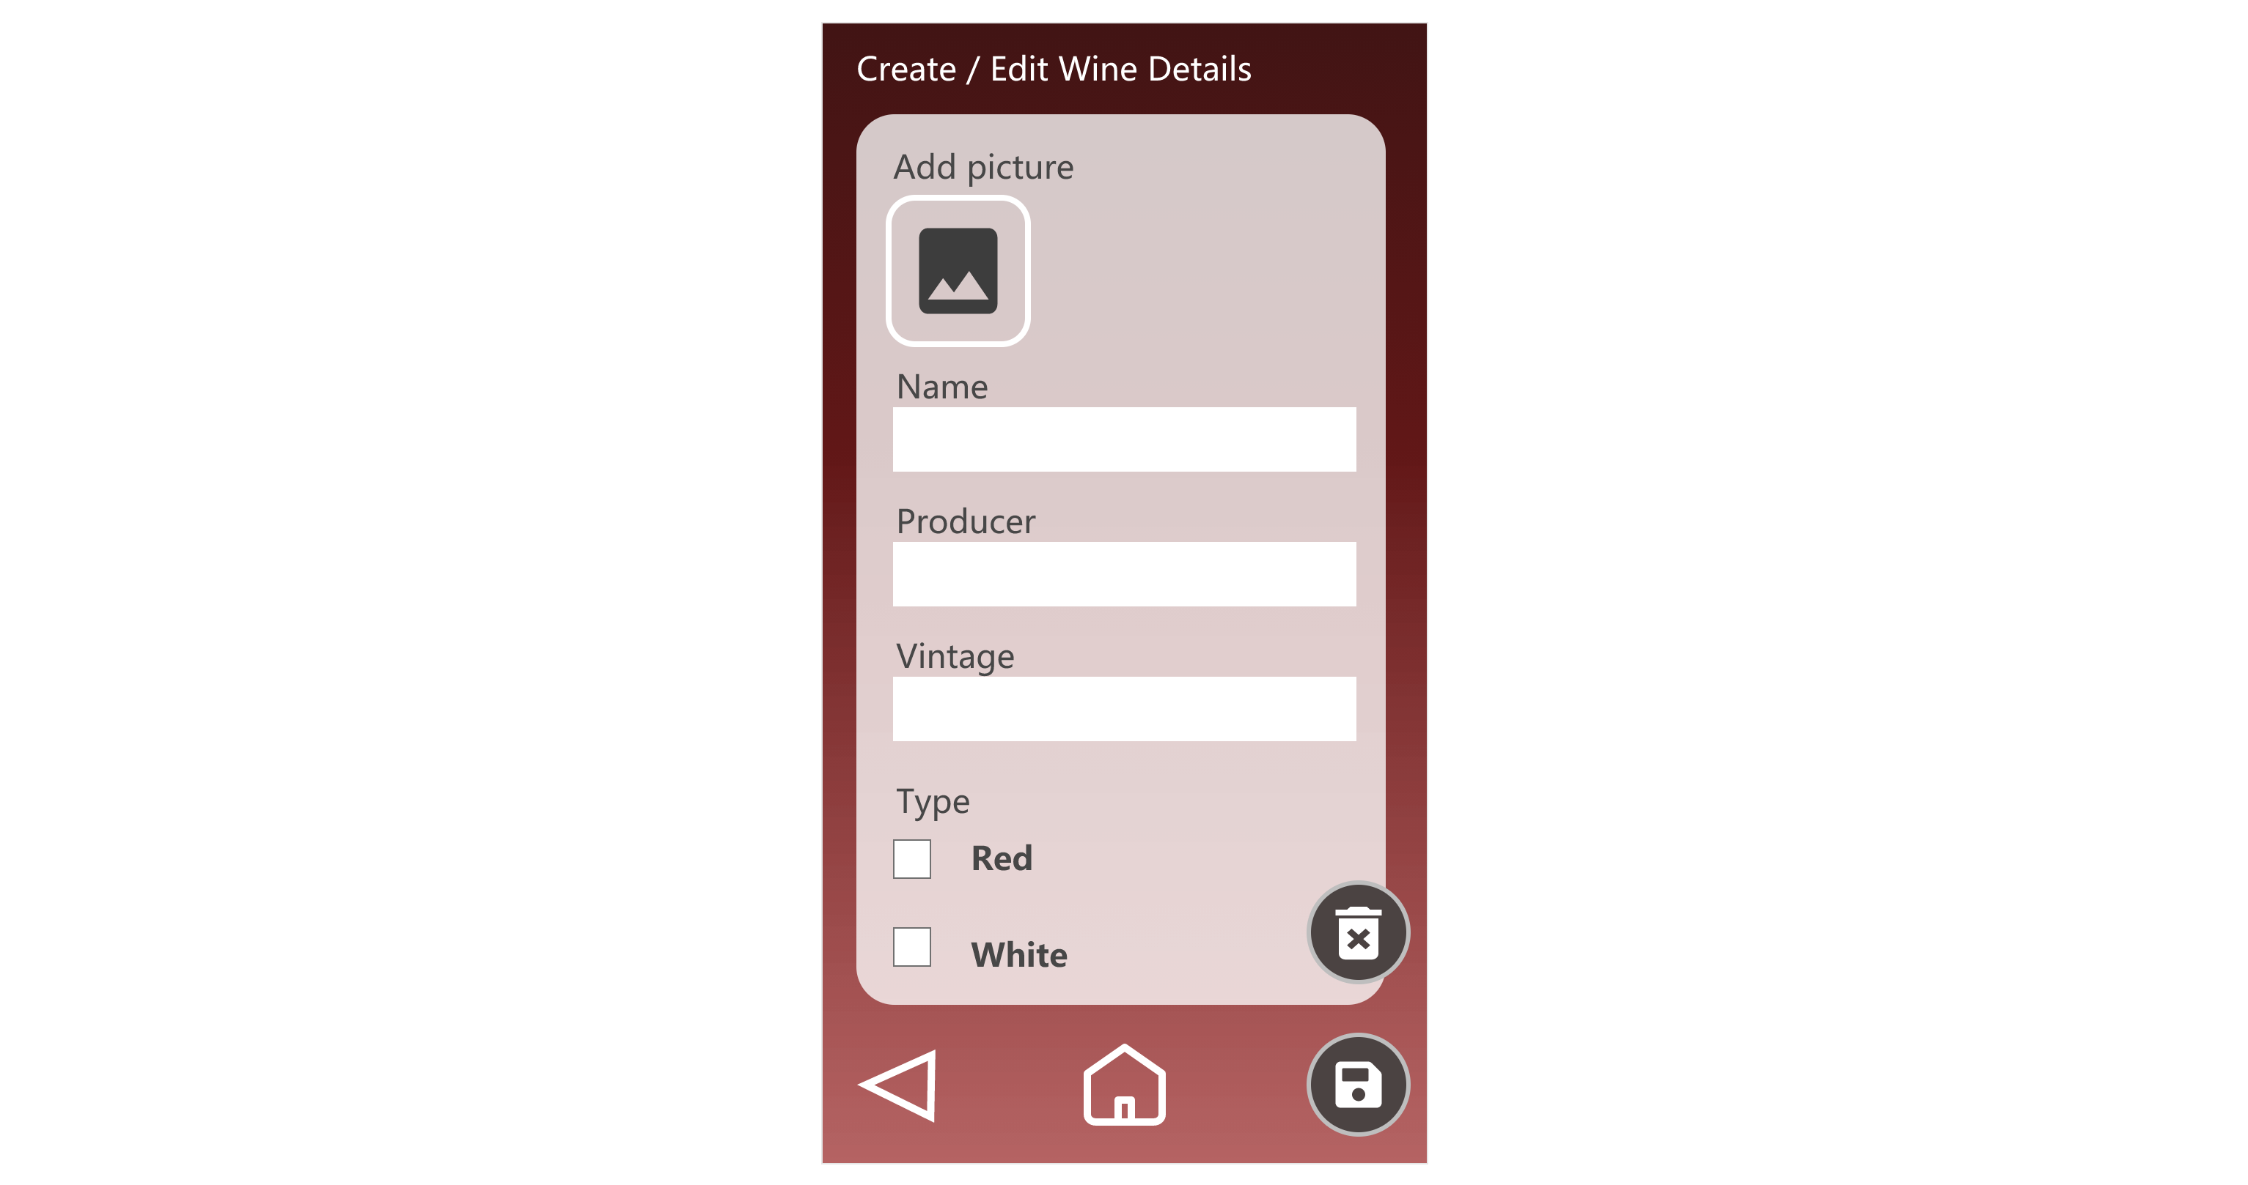
CREATE / EDIT PRODUCT’S DETAILS
For the Create form, the user will fill the same information about the wine as described in the wine details view (some details will be mandatory such as the name and vintage).
For the Edit form, the form will be similar as the Create form (since it’s the same details), but the fields and values will already be completed with the wine information taken from the database for that wine ID. Can also delete the wine entry.

Slide 11
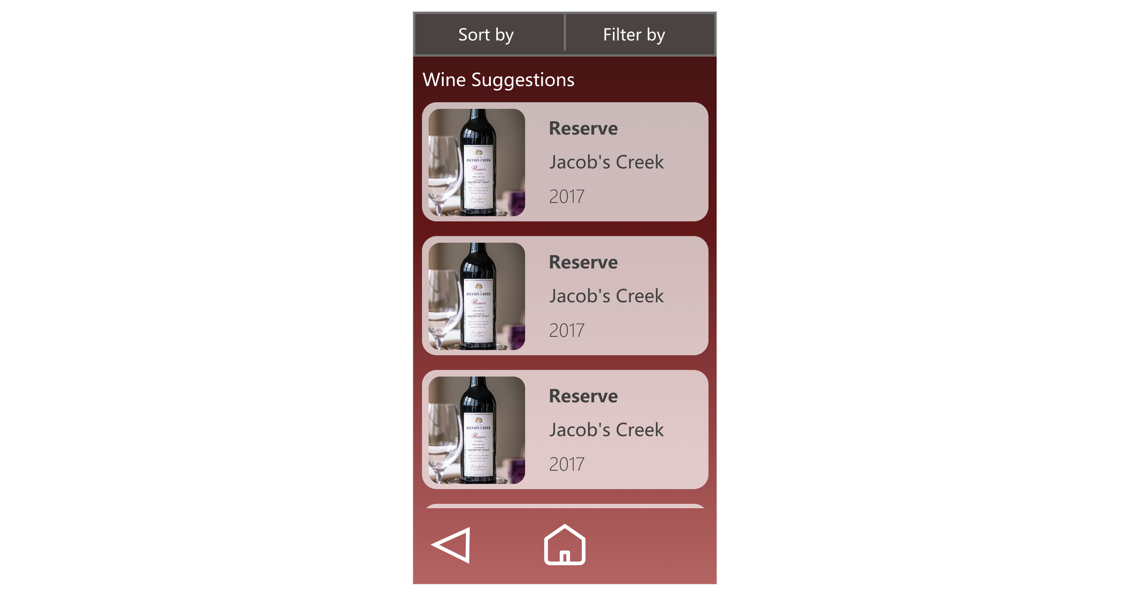
WINE SUGGESTIONS
Will display a list of wine suggestions taken from the Internet using JSON/GSON and wine API.
The details of the wines will depend on the values/attributes in the API.

Slide 12
SETTINGS
We are still not sure, but we think to include a settings to the application as well that could include:
Different themes
Language

Slide 13
DATABASE
Tasted Collection table | Untasted Collection table
PK | WineID
 | Name
 | Producer
 | Vintage
 | Picture
 | Type
 | Rating
 | Quantity
 | Price
 | Additional_Information
PK​ | WineID​
​ | Name​
​ | Producer​
​ | Vintage​
​ | Picture​
​ | Type​
​ | Quantity​
​ | Price​
​ | Additional_Information​

Slide 14
DATABASE
Login table
PK | UserID
 | Username
 | Password

Slide 15
FINAL WORDS
MyCellar application in only the first prototype of our project. New features might be added in order to make the project more challenging and exciting.
GitHub link: https://github.com/VeroKar/Application_Development_Project.git

